Slide 1

CERTIFICATE III IN AUTOMOTIVE REPAIR & MAINTENANCE
SUBJECT: VEHICLE MAINTENACE AND REPAIR
By Ibrahim siraj
Maldives polytechnic

Slide 2
VEHICLE MAINTENACE AND REPAIR
Chapter 8 Service Diesel Fuel System
Introduction
A car's diesel engine system operates on a four-stroke cycle that uses compression to ignite fuel, unlike gasoline engines that use spark plugs. The system draws air into the cylinder, compresses it to high temperatures, injects diesel fuel which then spontaneously combusts, and expels the exhaust gases. Key components include the fuel injection system, which delivers fuel into the cylinder, and the turbocharger, which forces more air into the cylinders to increase power and efficiency
By Ibrahim siraj
Maldives polytechnic

Slide 3
VEHICLE MAINTENACE AND REPAIR
Chapter 8 Service Diesel Fuel System
The primary systems in a car diesel engine include
Fuel System: Consists of the fuel tank, a low-pressure transfer pump, fuel filters (including a water separator), a high-pressure pump, and fuel injector nozzles. Modern systems often use high-pressure common rail injection for precision.
Air Intake System: Includes an air filter and, in most modern diesel cars, a turbocharger which compresses incoming air to increase the amount of oxygen available for a more efficient and powerful combustion.
Exhaust System: Manages the exit of combustion gases and includes emission control devices like a diesel particulate filter (DPF) to trap soot and a selective catalytic reduction (SCR) system (using Diesel Exhaust Fluid or DEF) to reduce nitrogen oxides (NOx).
Cooling System: Circulates coolant through the engine block and cylinder head to maintain optimal operating temperatures and prevent overheating
By Ibrahim siraj
Maldives polytechnic

Slide 4
VEHICLE MAINTENACE AND REPAIR
Chapter 8 Service Diesel Fuel System
The primary systems in a car diesel engine include
Lubrication System: Circulates engine oil to reduce friction between moving parts (like pistons, crankshaft, and camshaft) and dissipate heat.
Electrical System: Primarily provides power for starting the engine (battery and starter motor), running onboard electronics (alternator), and operating glow plugs (small electric heaters that aid cold starting by pre-heating the combustion chamber).
Engine Control Module (ECM): An electronic unit that monitors sensors throughout the engine and controls critical functions like fuel mixture, injection timing, and emissions systems for optimal performance and efficiency.
By Ibrahim siraj
Maldives polytechnic

Slide 5
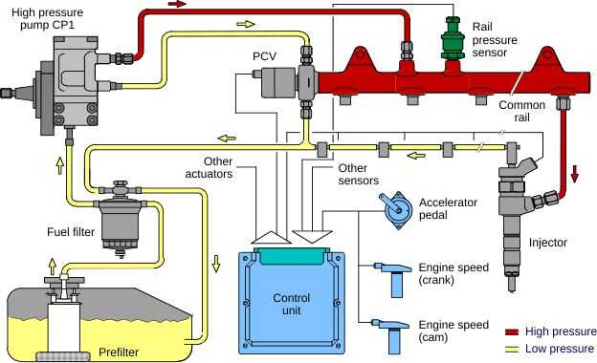
VEHICLE MAINTENACE AND REPAIR
Chapter 8 Service Diesel Fuel System
By Ibrahim siraj
Maldives polytechnic

Slide 6
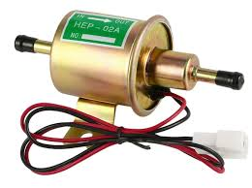
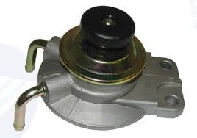
VEHICLE MAINTENACE AND REPAIR
Chapter 8 Service Diesel Fuel System
Diesel Lift Pump
A diesel lift pump is a low-pressure fuel pump that transfers diesel fuel from the tank to the high-pressure injection pump
ensuring a consistent and clean fuel supply to the engine. It is a crucial component for optimal performance, as it reduces the strain on the injection pump and prevents fuel starvation. Lift pumps are available as either mechanical or electric and come in various flow rates and pressures
By Ibrahim siraj
Maldives polytechnic

Slide 7
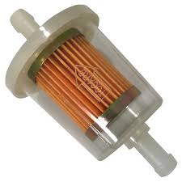
VEHICLE MAINTENACE AND REPAIR
Chapter 8 Service Diesel Fuel System
Diesel Fuel Filter
A diesel fuel filter is a critical component that removes contaminants, dirt, and water from diesel fuel to protect the engine and fuel system
By ensuring clean, dry fuel reaches the engine, it prevents damage to expensive components like fuel injectors and pumps, which is especially important for modern high-pressure common rail systems
By ensuring clean, dry fuel reaches the engine, it prevents damage to expensive components like fuel injectors and pumps, which is especially important for modern high-pressure common rail systems
Product Condition: Brand New
Disel Fuel Filter Fits For Hilux Coaster Series
OEM Number: 23390-64480
Cross-reference Numbers: SAKURA FC1105 SAKURA FC1707
By Ibrahim siraj
Maldives polytechnic

Slide 8
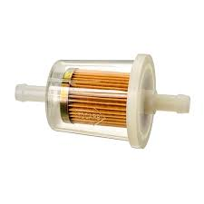
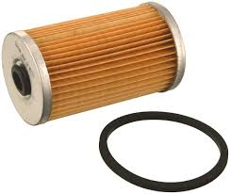
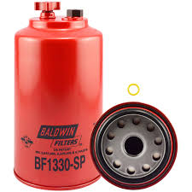
VEHICLE MAINTENACE AND REPAIR
Chapter 8 Service Diesel Fuel System
Types of Diesel Fuel Filters
Diesel fuel filters generally fall into a few primary types based on their design and location in the fuel system.
In-line Fuel Filters: These are typically simple, disposable units installed in the fuel line itself.
Cartridge Fuel Filters: These use a replaceable filter element within a permanent housing, often with a transparent bowl and drain valve to visually inspect and remove water or impurities.
Spin-on Fuel Filters: These filters have a metal canister housing that spins onto a base on the engine or fuel system, similar to an oil filter
By Ibrahim siraj
Maldives polytechnic

Slide 9
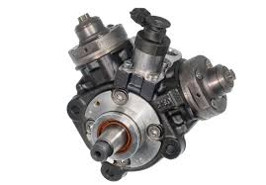
VEHICLE MAINTENACE AND REPAIR
Chapter 8 Service Diesel Fuel System
High Pressure Fuel pump
A high-pressure fuel pump (HPFP) is a critical component in modern gasoline direct injection and diesel engines that pressurizes fuel to a high level for direct injection into the engine's combustion chambers.
This high-pressure, fine fuel spray improves engine performance, fuel economy, and reduces emissions by allowing for more complete and efficient combustion. HFPFs are typically driven mechanically by the camshaft and are essential for both types of modern engines
By Ibrahim siraj
Maldives polytechnic

Slide 10
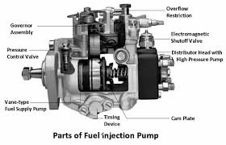
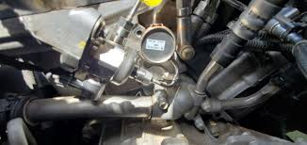
VEHICLE MAINTENACE AND REPAIR
Chapter 8 Service Diesel Fuel System
High Pressure Fuel pump
Location and drive
Location: Usually mounted on the engine.
Drive: Mechanically driven by a dedicated lobe on the engine's camshaft
By Ibrahim siraj
Maldives polytechnic

Slide 11
VEHICLE MAINTENACE AND REPAIR
Chapter 8 Service Diesel Fuel System
High Pressure Fuel pump
Function
Pressurizes fuel: Takes low-pressure fuel from the fuel tank and increases its pressure to the high levels required for direct injection.
Provides precise fuel delivery: Delivers fuel to the injectors at the precise pressures needed for efficient combustion, which is especially critical in diesel engines.
Improves engine performance: The high-pressure fuel spray creates a finer, more atomized mist, which leads to better combustion, increased power, and better fuel efficiency.
Reduces emissions: More efficient combustion results in lower exhaust emission
By Ibrahim siraj
Maldives polytechnic

Slide 12
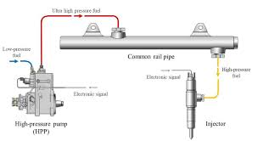
VEHICLE MAINTENACE AND REPAIR
Chapter 8 Service Diesel Fuel System
The main types of high-pressure fuel systems
High-Pressure Common Rail (HPCR)
Electronic Unit Injector (EUI
Hydraulically Actuated Electronic Unit Injector (HEUI
High-Pressure Common Rail (HPCR)
In this system, a high-pressure pump supplies fuel to a common "rail" which acts as a high-pressure accumulator. Injectors then draw fuel from this rail and inject it into the cylinders. It's a common and widely used system in modern diesel engines
By Ibrahim siraj
Maldives polytechnic

Slide 13
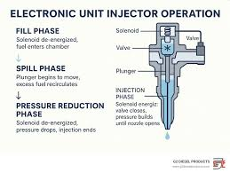
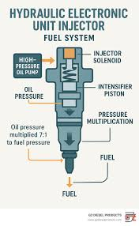
VEHICLE MAINTENACE AND REPAIR
Chapter 8 Service Diesel Fuel System
The main types of high-pressure fuel systems
Electronic Unit Injector (EUI
Each cylinder has its own dedicated injector and pump unit. The pump is mechanically driven by the engine, but electronically controlled for precise timing and fuel delivery
Hydraulically Actuated Electronic Unit Injector (HEUI)
Similar to EUI, but it uses engine oil pressure to actuate the injector's plunger, which then pressurizes the fuel. This system is also electronically controlled
By Ibrahim siraj
Maldives polytechnic

Slide 14
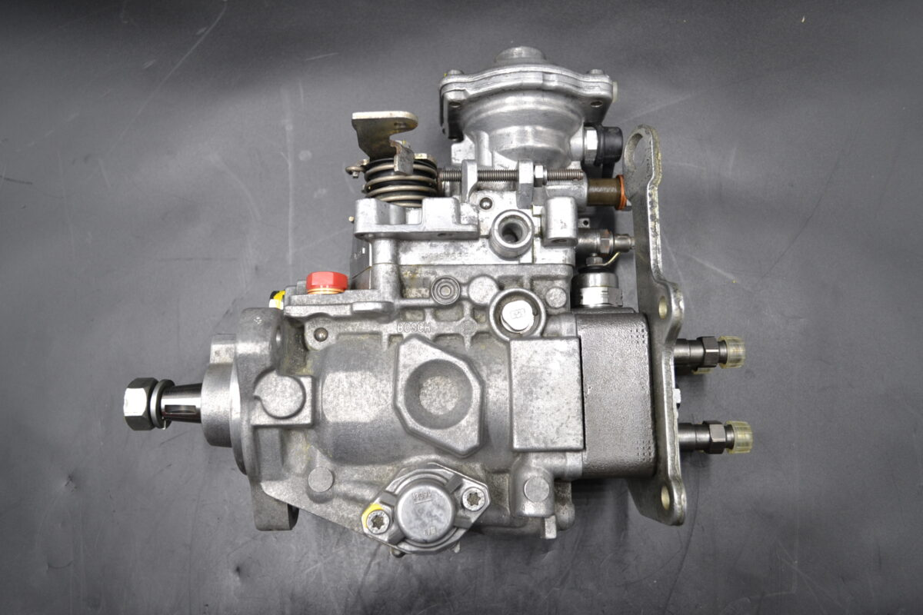
VEHICLE MAINTENACE AND REPAIR
Chapter 8 Service Diesel Fuel System
The main types of high-pressure fuel systems
Distributor Injection Pumps
In this older type of system, one central pump generates high pressure and then distributes the metered fuel to each cylinder's injector in the correct firing order, using a rotating distributor mechanism. While less common in modern high-pressure applications compared to common rail systems, they were widely used in many older diesel engines.
By Ibrahim siraj
Maldives polytechnic

Slide 15
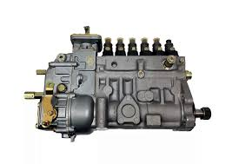
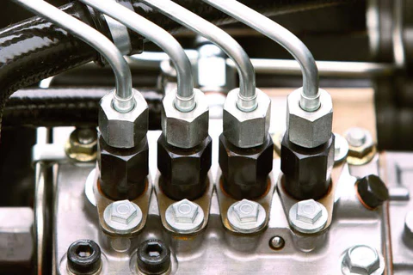
VEHICLE MAINTENACE AND REPAIR
Chapter 8 Service Diesel Fuel System
The main types of high-pressure fuel systems
Individual (Inline) Injection Pumps
historically significant system, this setup uses a series of individual pumping elements, one for each cylinder, arranged in a line. A single camshaft operates all the elements, and the amount of fuel is controlled by a rack and pinion system (helix-controlled pumps). This design is robust and was common in many heavy-duty diesel engines
By Ibrahim siraj
Maldives polytechnic

Slide 16
VEHICLE MAINTENACE AND REPAIR
Chapter 8 Service Diesel Fuel System
Fuel Injector
Diesel fuel injectors are precision components in a diesel engine that atomize and inject a precise amount of fuel into the combustion chamber at the exact right moment for optimal combustion
Common Rail (CR) Injectors: These are the most prevalent type in modern diesel engines, known for improved efficiency, lower emissions, and quieter operation. They operate within a system where a single high-pressure pump continuously supplies a shared fuel rail (accumulator) with fuel at extremely high pressure (up to 30,000 psi or more
Unit Injectors (UI) / Pumpe Düse (PD): In a unit injector system, the high-pressure pump and the injector nozzle are combined into a single, self-contained unit located in the cylinder head. High pressure is generated within the injector unit itself, typically by a plunger driven by the engine's camshaft, just before injection occurs.
Mechanical Injectors: Found in older diesel engines, these rely on a mechanical injection pump to generate high pressure and time the fuel delivery to each injector through individual fuel lines.
By Ibrahim siraj
Maldives polytechnic

Slide 17
VEHICLE MAINTENACE AND REPAIR
Chapter 8 Service Diesel Fuel System
Fuel Injector
Key Components of a Diesel Fuel Injector
Nozzle/Spray Tip: This is the critical component that atomizes the fuel into a fine mist and controls the spray pattern for optimal mixing with air and efficient combustion.
Needle Valve/Pintle: A valve that works in tandem with the nozzle, opening and closing to regulate the flow of fuel.
Solenoid/Piezo Actuator: In electronically controlled injectors (like common rail and some unit injectors), this electrical component receives a signal from the ECU to open or close the needle valve with high speed and precision.
Pressure Spring: This spring provides resistance to the internal components, helping to control the opening and closing of the nozzle and ensuring proper fuel pressure is maintained within the injector until the precise moment of injection.
Injector Body: The main housing that contains and provides structural support for all the internal parts.
Fuel Inlet and Filter Basket: High-pressure fuel enters the injector through the inlet, passing through a small filter to prevent debris from clogging the precision components
By Ibrahim siraj
Maldives polytechnic

Slide 18
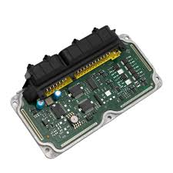
VEHICLE MAINTENACE AND REPAIR
Chapter 8 Service Diesel Fuel System
Fuel Injector
Engine Control Unit (ECU)
An Engine Control Unit (ECU), also known as an Engine Control Module (ECM), is the central computer that monitors and manages an internal combustion engine's critical functions to ensure optimal performance, efficiency, and emissions control. It acts as the "brain" of the engine management system
By Ibrahim siraj
Maldives polytechnic

Slide 19
VEHICLE MAINTENACE AND REPAIR
Chapter 8 Service Diesel Fuel System
Fuel Injector
Engine Control Unit (ECU) Operation
The ECU operates in a continuous feedback loop, relying on three fundamental stages: input, processing, and output
Input (Sensors): The ECU receives real-time data from a network of sensors located throughout the engine and vehicle. These sensors measure various operating conditions:
Crankshaft and Camshaft Position Sensors: Provide information on engine speed and the exact position of engine parts for precise timing.
Mass Air Flow (MAF) / Manifold Absolute Pressure (MAP) Sensors: Measure the amount/pressure of air entering the engine to determine the correct air-fuel mixture.
Oxygen (O2) Sensors: Monitor the oxygen content in the exhaust gases to ensure the air-fuel ratio is optimal for efficient combustion and emissions.
Coolant Temperature Sensor: Provides data on engine temperature, allowing the ECU to adjust parameters for cold starts or prevent overheating.
Throttle Position Sensor: Reports the accelerator pedal's position to gauge the driver's power demand.
By Ibrahim siraj
Maldives polytechnic

Slide 20
VEHICLE MAINTENACE AND REPAIR
Chapter 8 Service Diesel Fuel System
Fuel Injector
Engine Control Unit (ECU) Operation
The ECU operates in a continuous feedback loop, relying on three fundamental stages: input, processing, and output
2. Processing (Microcomputer): The ECU's internal microprocessor (CPU) and memory instantly process the input data using pre-programmed software and complex algorithms. It compares the real-time data against optimal performance maps stored in its memory to make millions of calculations per second.
By Ibrahim siraj
Maldives polytechnic

Slide 21
VEHICLE MAINTENACE AND REPAIR
Chapter 8 Service Diesel Fuel System
Fuel Injector
Engine Control Unit (ECU) Operation
The ECU operates in a continuous feedback loop, relying on three fundamental stages: input, processing, and output
3. Output (Actuators): Based on its calculations, the ECU sends command signals to various actuators to implement the necessary adjustments: Fuel Injectors: The ECU precisely controls the timing and duration of fuel injection to regulate the air-fuel mixture.
Ignition Coils: Manages the timing of the spark plugs' firing to maximize power output and efficiency.
Electronic Throttle Control: Modulates the throttle valve opening to control engine speed and air intake.
Idle Air Control Valve: Regulates the engine's idle speed.
Variable Valve Timing (VVT) Systems: Adjusts valve timing for improved power, torque, and emissions.
Cooling System Components: Activates cooling fans or regulates the thermostat to manage engine temperature
By Ibrahim siraj
Maldives polytechnic

Slide 22
VEHICLE MAINTENACE AND REPAIR
Chapter 8 Service Diesel Fuel System
Fuel Injector
Engine Control Unit (ECU) Operation
Key Functions
The ECU manages a wide array of engine and vehicle functions, including:
Fuel Injection Control: Regulates the amount of fuel supplied to the cylinders.
Ignition Timing Control: Determines the precise moment the spark plugs fire.
Emissions Control: Manages systems like exhaust gas recirculation (EGR) and catalytic converters to meet environmental regulations.
Idle Speed Control: Maintains a stable idle under varying loads.
Diagnostics: Continuously monitors system health, stores diagnostic trouble codes (DTCs) in memory, and triggers the "check engine" light if issues arise.
Communication: Interacts with other vehicle control units (e.g., transmission control unit, anti-lock braking system) via a network like the CAN bus to coordinate operations.
By Ibrahim siraj
Maldives polytechnic

Slide 23
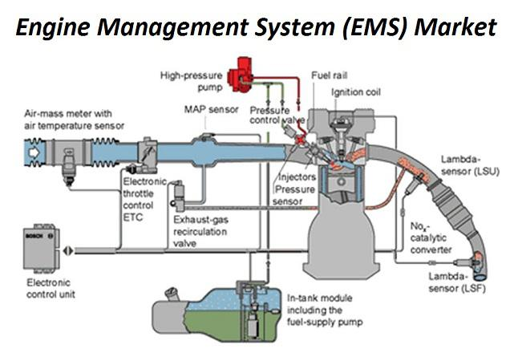
VEHICLE MAINTENACE AND REPAIR
Chapter 8 Service Diesel Fuel System
Fuel Injector
Engine Control Unit (ECU) Operation
By Ibrahim siraj
Maldives polytechnic

Slide 24
THANK YOU

